Slide 1


Slide 2
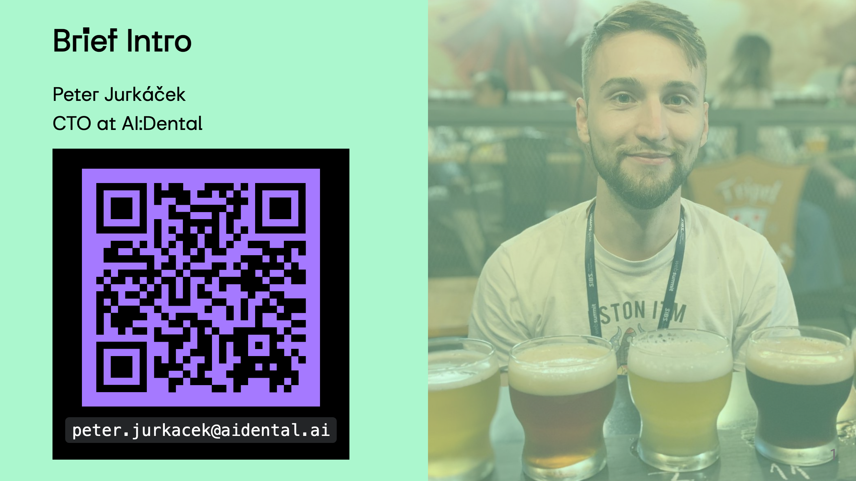
Notes:
"Hi everyone, I'm [Your Name], the CTO of [Your AI Company]. Beyond the world of technology, I'm passionate about sports, enjoy a good cup of coffee, and appreciate the art of craft beer. Today, I'm not just here to talk tech; I'm open to connecting on shared interests. Scan the QR code on my Linked for a virtual meetup. Let's dig in" References https://www.ncbi.nlm.nih.gov/pmc/articles/PMC8238744/ https://pubmed.ncbi.nlm.nih.gov/30861309/ https://www.ncbi.nlm.nih.gov/pmc/articles/PMC9026102/ https://www.ncbi.nlm.nih.gov/pmc/articles/PMC5334326/ https://www.researchgate.net/publication/ (1996 Room for improvement? The accuracy of dental practitioners who diagnose bony pathoses with radiographs)[https://pubmed.ncbi.nlm.nih.gov/8665324/]

Slide 3

Notes:
--- To democratize dental health through AI by enhancing precision, affordability, and accessibility in education and patient care. Shaping the future of the dentistry through creating the conditions for everyone to access the affordable and personalised healthcare.

Slide 4
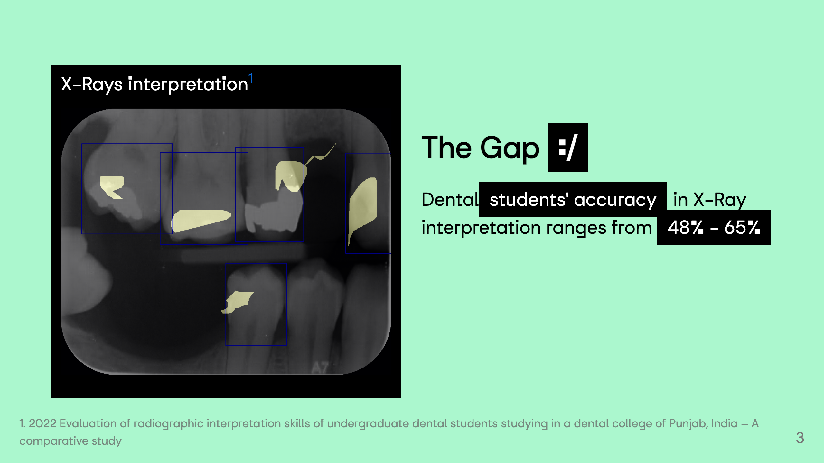
Notes:
Interpretation of dental X-rays is essential in making an accurate diagnosis, performing dental procedures, in evaluating procedural success and in documentation of dental and oral health - error-prone process, even for experts - low-prevalence anomalies. it means that the condition is not commonly observed in the general population (Carotid artery calcifications) ![](img/qexample.png)

Slide 5
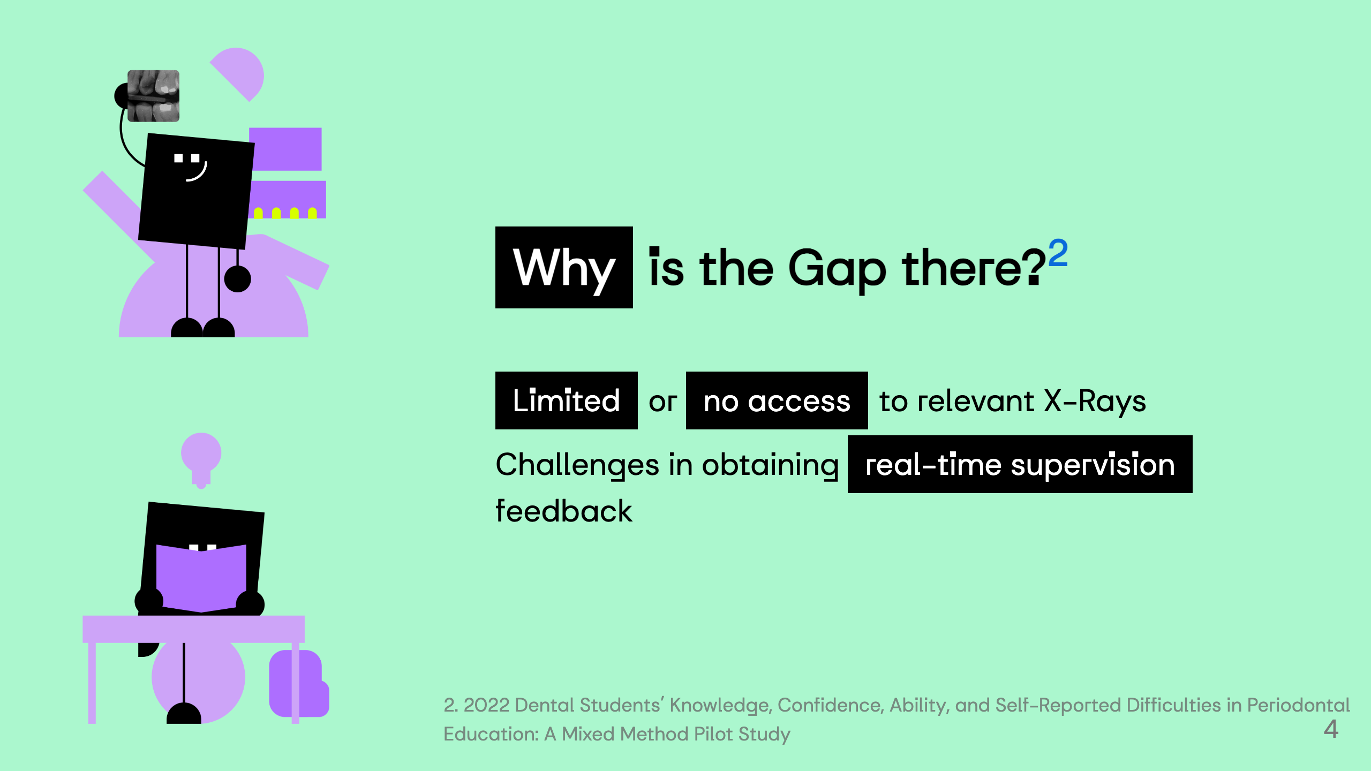

Slide 6
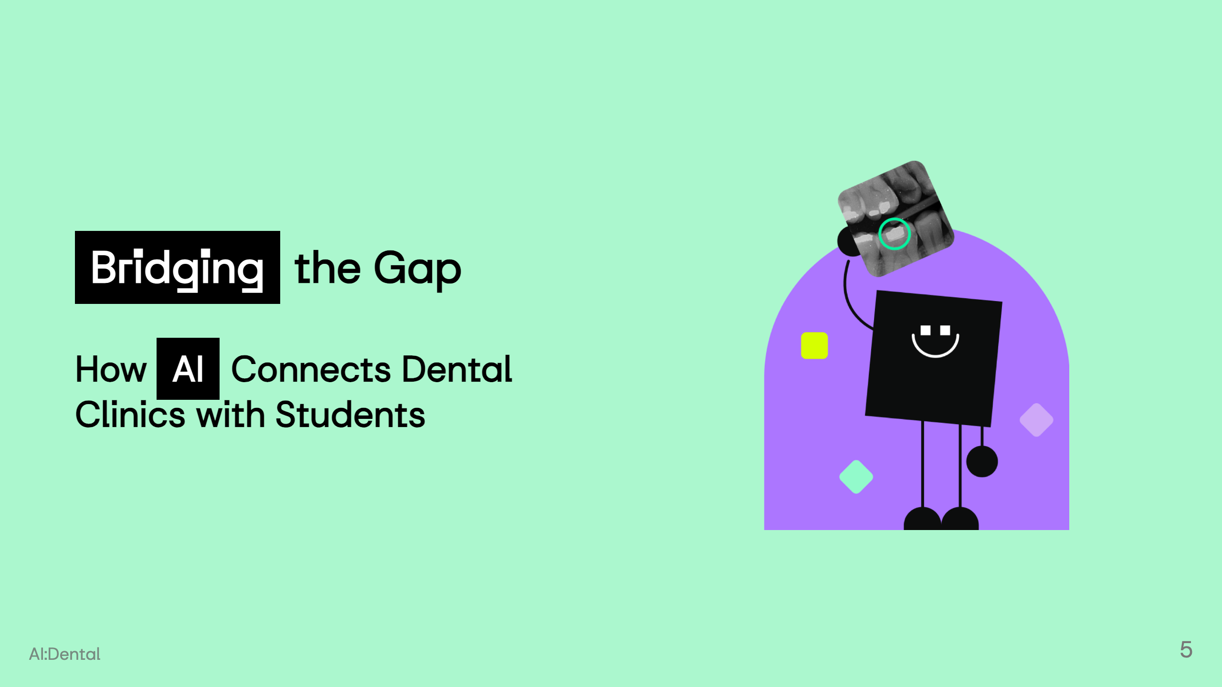

Slide 7
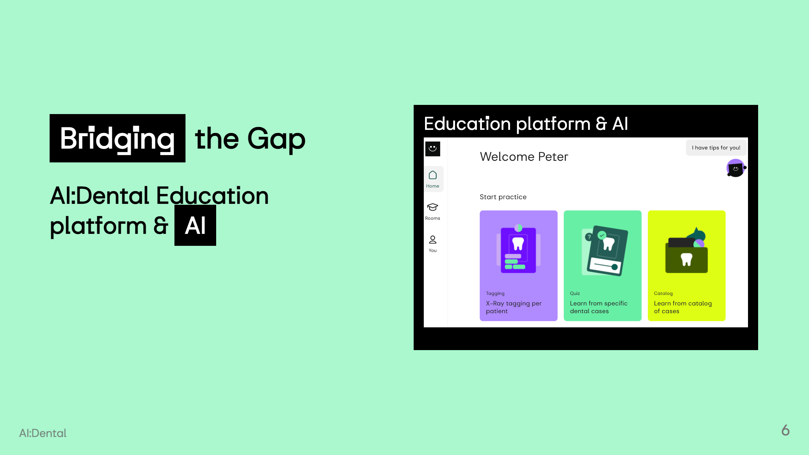

Slide 8
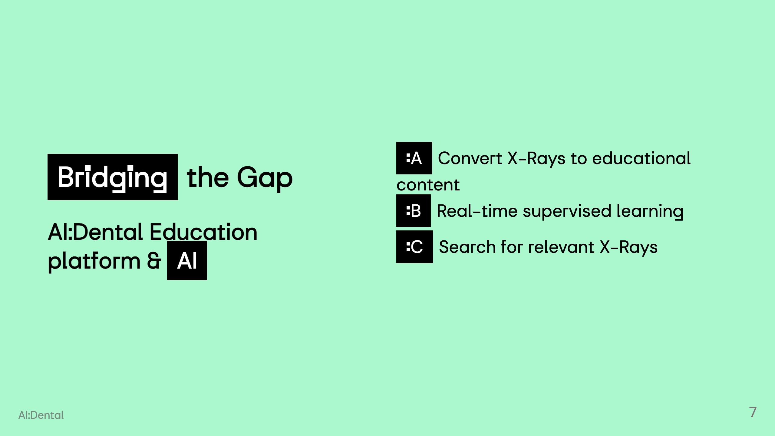

Slide 9
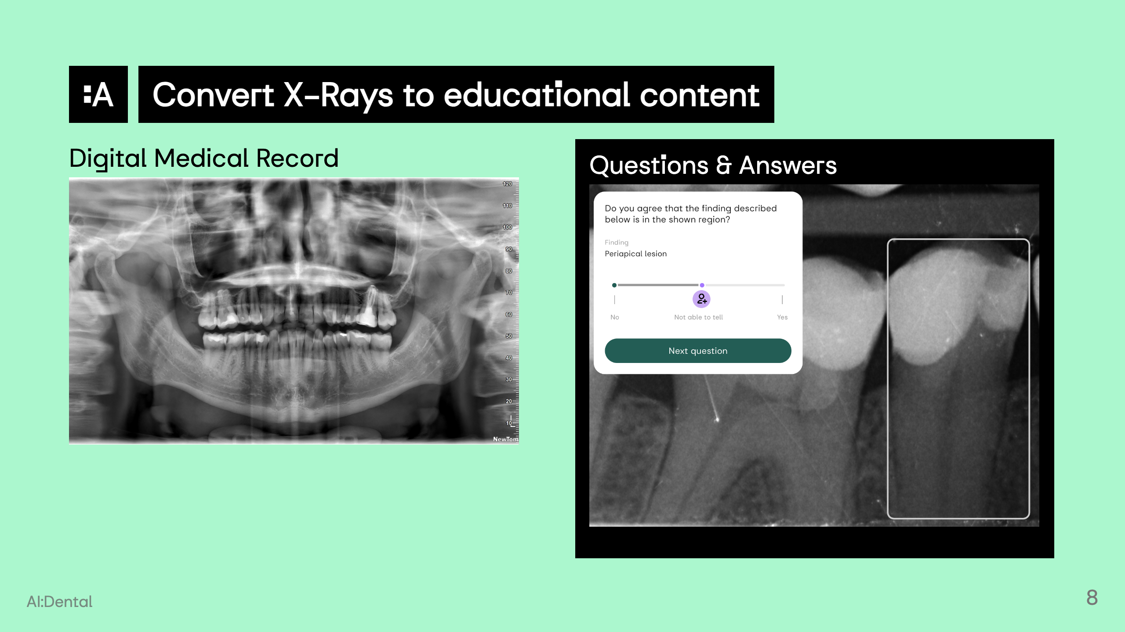
Notes:
![w:256](EMR_semafor.png)

Slide 10
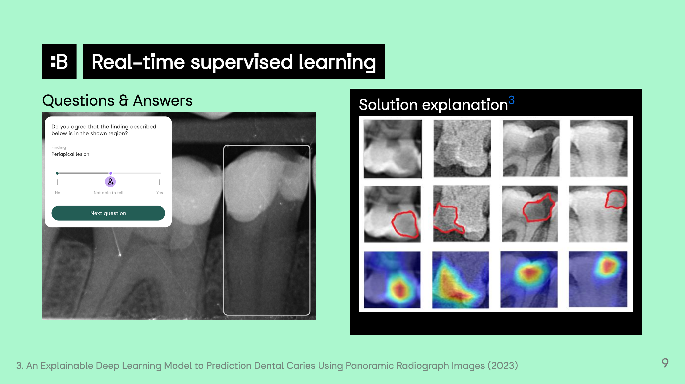

Slide 11
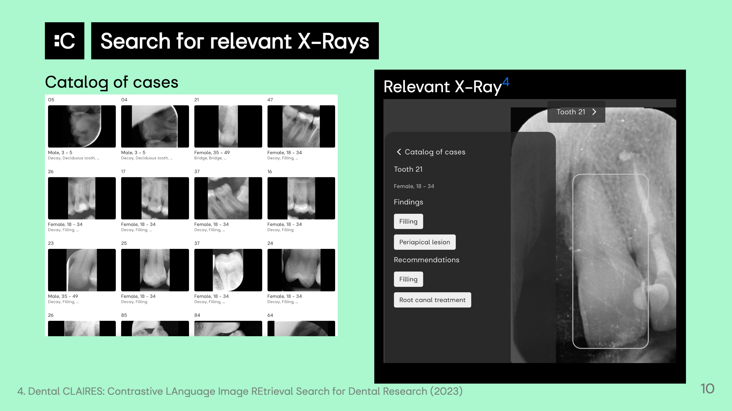
Notes:
https://www.sciencedirect.com/science/article/pii/S2772442523001491 https://www.mdpi.com/2075-5309/13/2/275 https://www.ncbi.nlm.nih.gov/pmc/articles/PMC10283104/

Slide 12
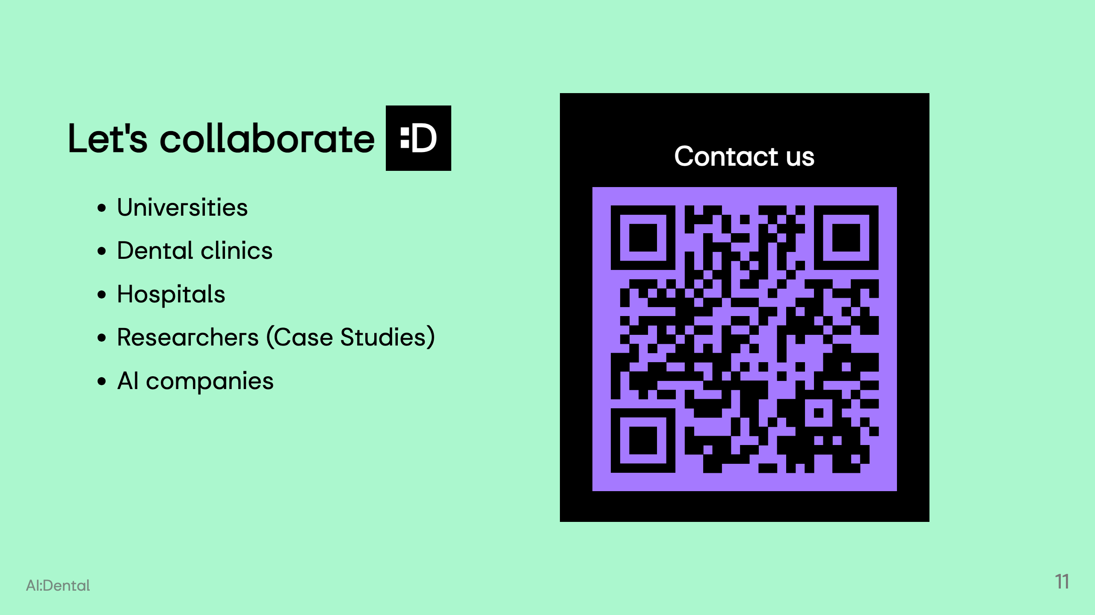

Slide 13
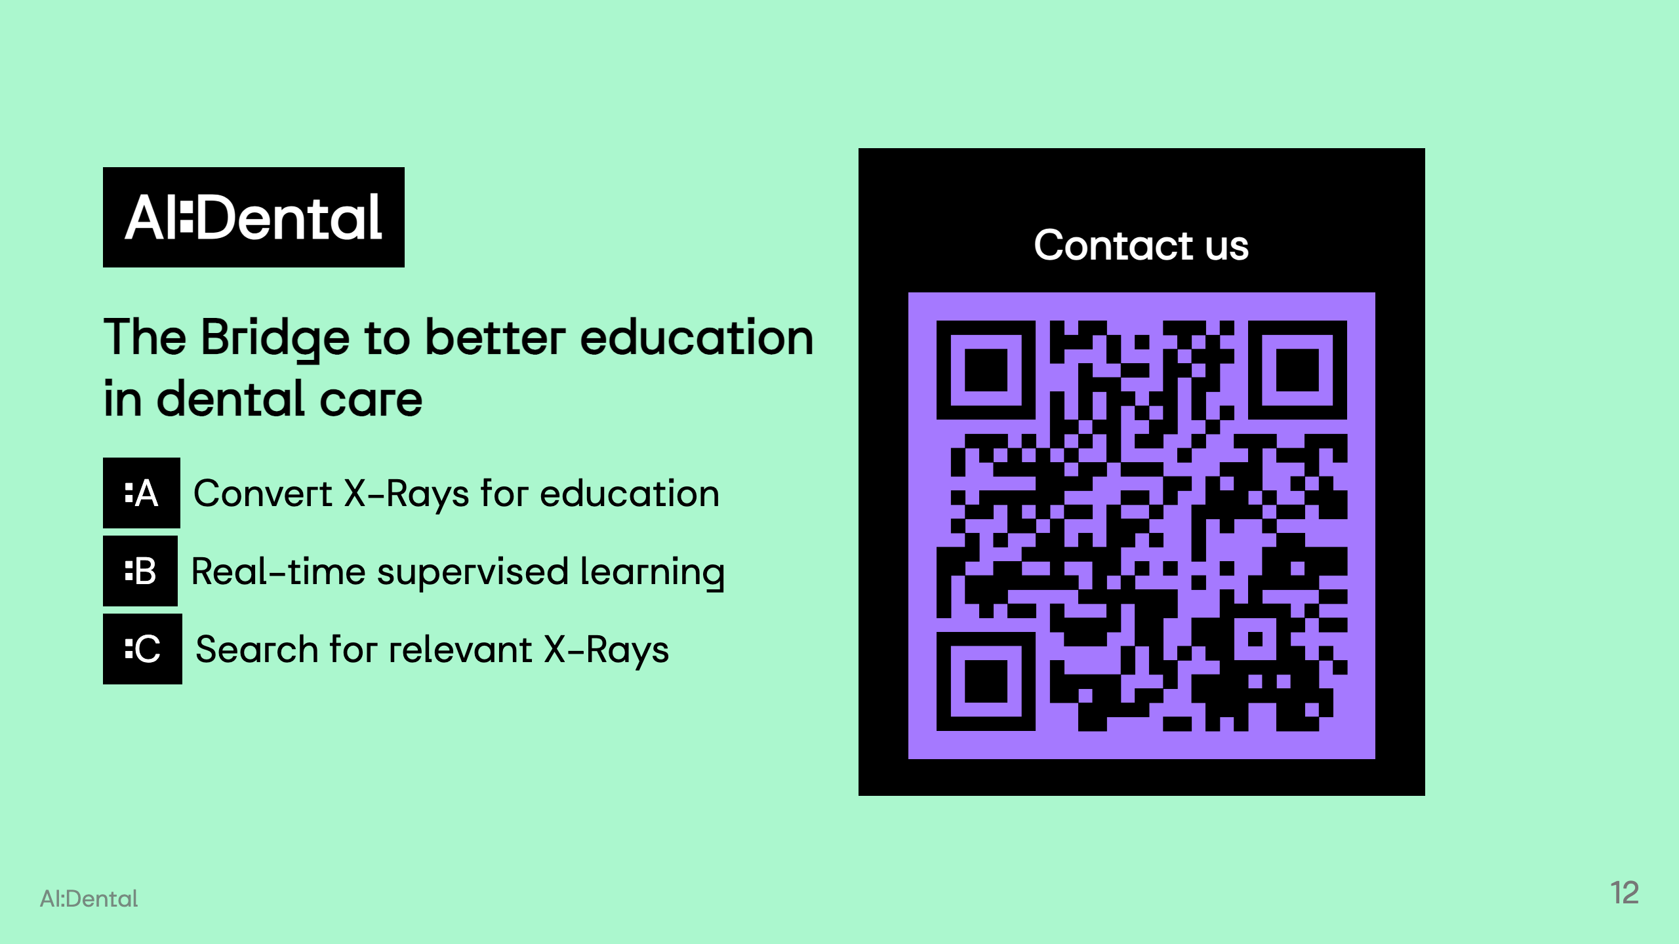
Notes:
To democratize dental health through AI by enhancing precision, affordability, and accessibility in education and patient care. Shaping the future of the dentistry through creating the conditions for everyone to access the affordable and personalised healthcare.

